Slide 1
Deep Learning Modeling
in Genetics
Huaikuan Sun
12/13/2024

Slide 2
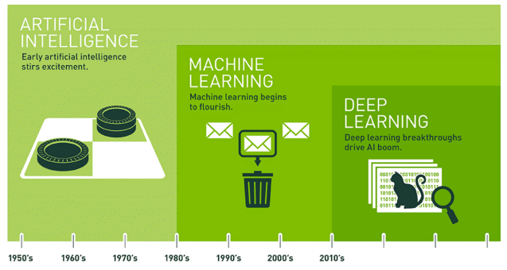
Index
A Brief Timeline of Deep-Learning Models
Protein Model
DNA Model
Mamba (2023)
Research Challenges

Slide 3
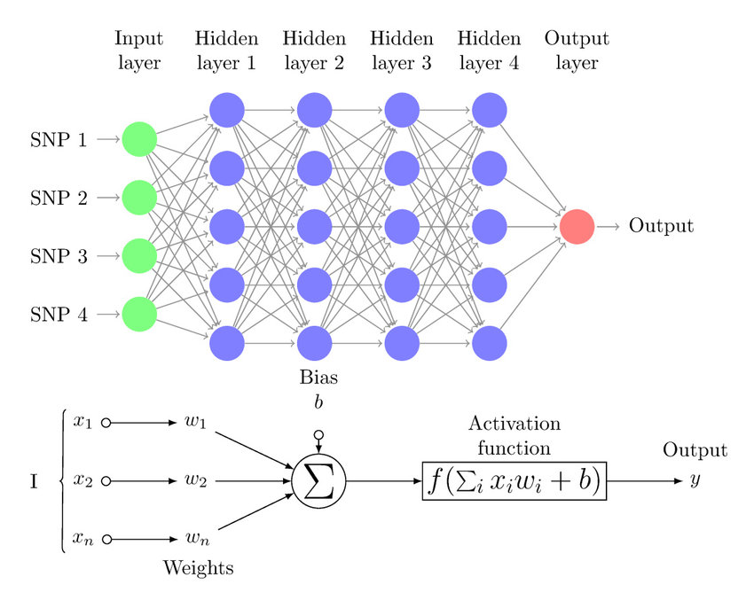
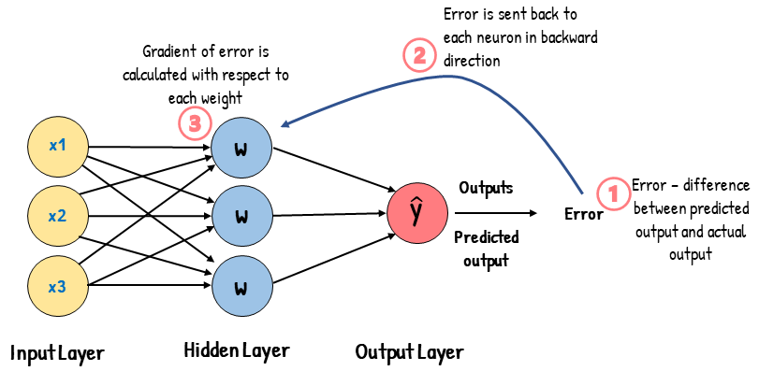
A Brief Timeline of Deep-Learning Models
1980’s
MLP & BP
2012
CNN
2014
RNN
Multi-Layer Perceptron
Back-Propagation Algorithm
2017
Transformer
2018
AlphaFold
Protein Model
2020
AlphaFold2
2022
GPN/DNABert2/NT
DNA Model
2023
HyenaDNA/Caduceus
2023
Mamba

Slide 4
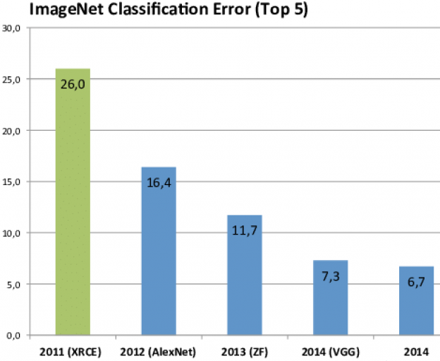
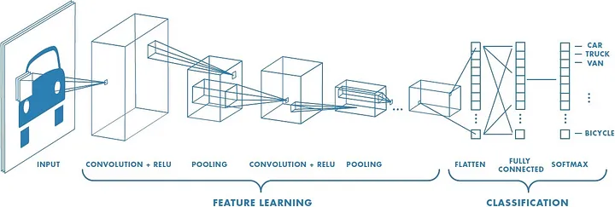
A Brief Timeline of Deep-Learning Models
1980’s
MLP & BP
2012
CNN
2014
RNN
2017
Image Classification
Object Detection
Transformer
2018
AlphaFold
Protein Model
2020
AlphaFold2
2022
GPN/DNABert2/NT
DNA Model
2023
HyenaDNA/Caduceus
2023
Mamba

Slide 5
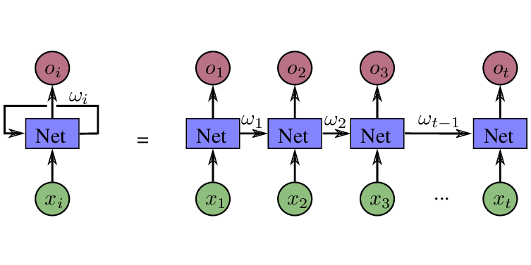
A Brief Timeline of Deep-Learning Models
1980’s
MLP & BP
2012
CNN
2014
RNN
Speech processing
Time series analysis
2017
Transformer
2018
AlphaFold
Protein Model
2020
AlphaFold2
2022
GPN/DNABert2/NT
DNA Model
2023
HyenaDNA/Caduceus
2023
Mamba

Slide 6
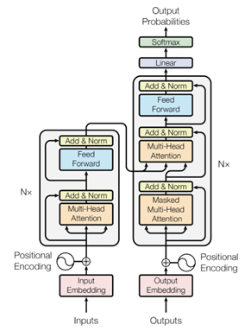
A Brief Timeline of Deep-Learning Models
Chatbots (GPT)
Question Answering (Bert)
Vision Transformer(ViT)
Machine Translation (Google Translate)
Text-to-Image Generation (DALL-E)
….
Foundation Model
1980’s
MLP & BP
2012
CNN
2014
RNN
2017
Transformer
2018
AlphaFold
Protein Model
2020
AlphaFold2
2022
GPN/DNABert2/NT
DNA Model
2023
HyenaDNA/Caduceus
2023
Mamba

Slide 7
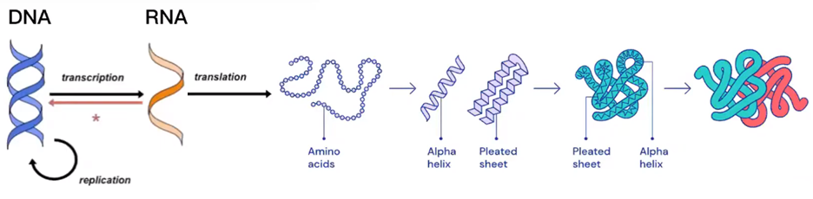
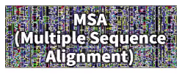
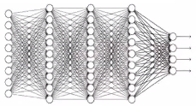
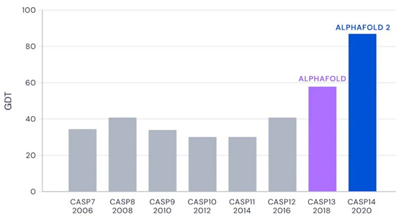
Protein Model
Critical Assessment of Structure Prediction (CASP )

Slide 8
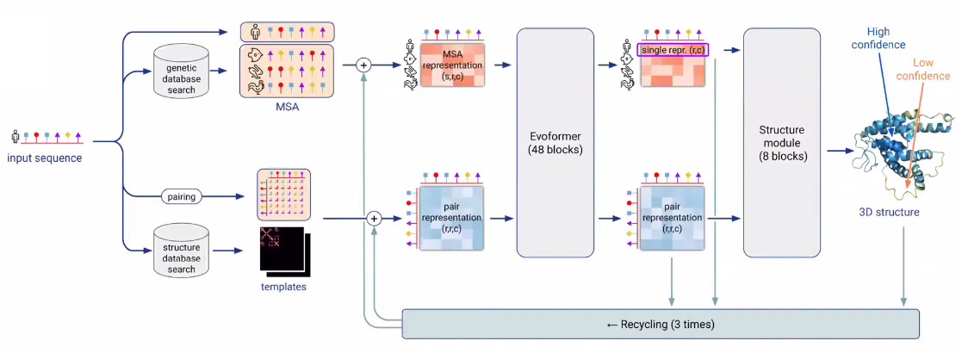
Protein Model
Input
MSA
Templates
Attention
Mechanism
3D Structure
Module
Output
AlphaFold2 Architecture

Slide 9
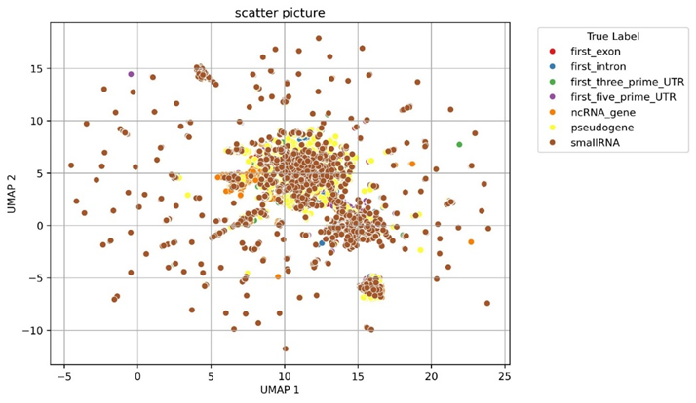
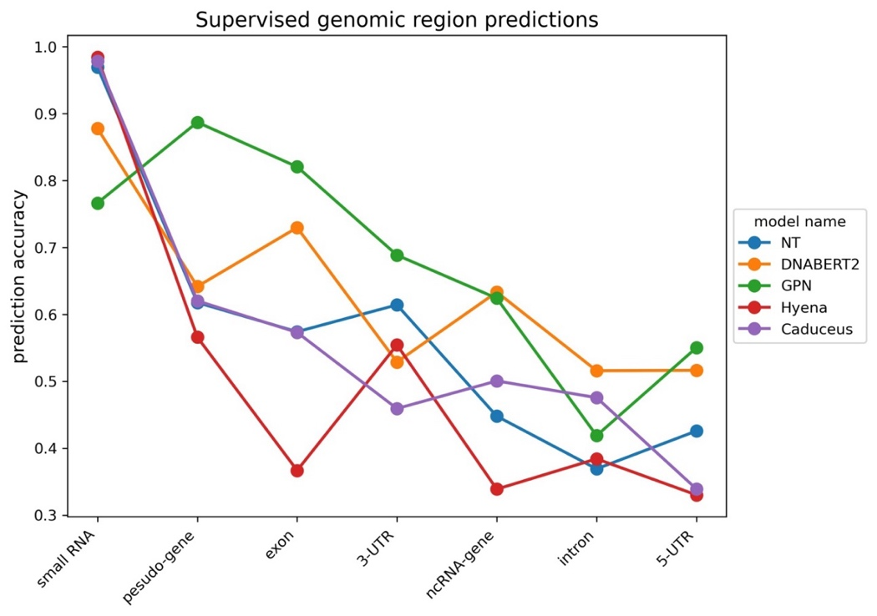
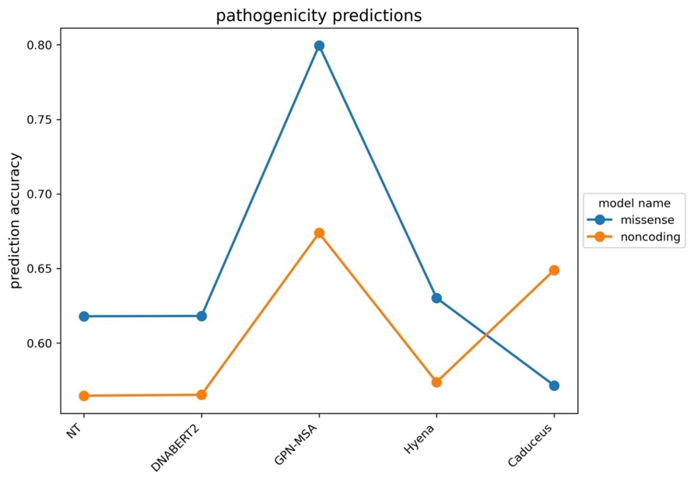
DNA Models
Model Name | GPN-MSA | Nucleotide Transformer | DNABERT-2 | HyenaDNA | Caduceus
Token | Base-Pair | 6-mer | K-mer | Base-Pair | Base-Pair
Max-Length | 128 | 6*128 | K*128 | 160K | 1M
Base Model | CNN/ Transformer | BERT/ Transformer | BERT/ Transformer | Hyena | Mamba

Slide 10
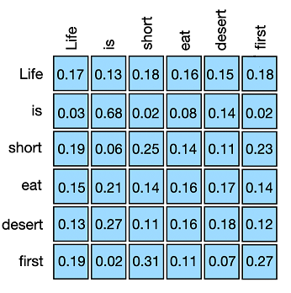
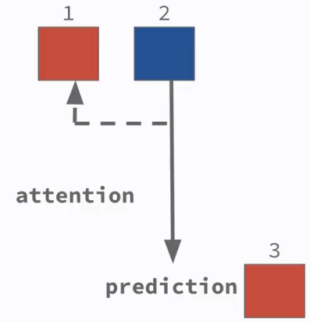
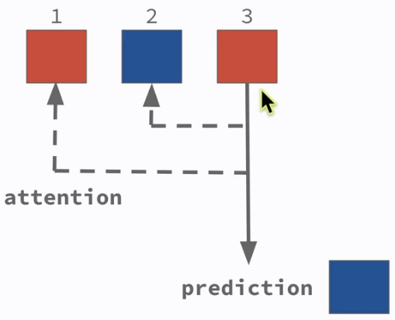
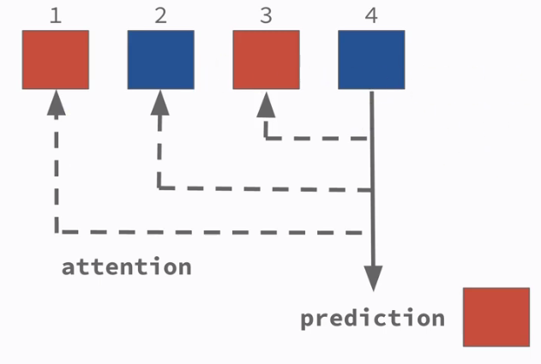
Mamba Model(2023)
Address the Shortcomes of Transformer
Quadratic Computation and Time Complexity:
Transformers have a self-attention mechanism that has quadratic complexity with respect to the sequence length.
Memory Requirements and Scalability :
As the input sequence length increases, the memory requirement grows substantially due to the need to store large attention matrices.
Self-Attention

Slide 11
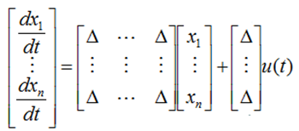
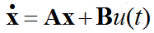
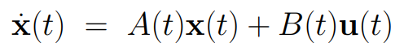
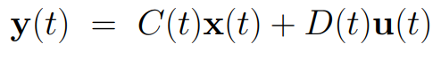
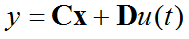
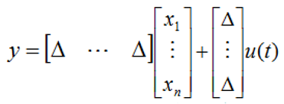
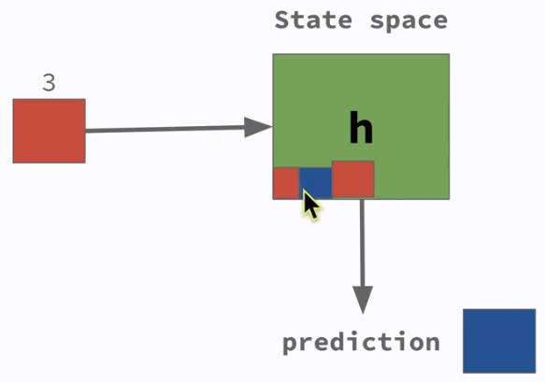
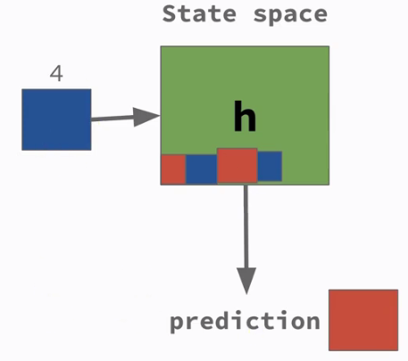
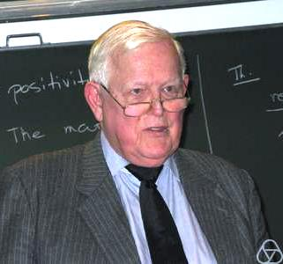
Mamba Model(2023)
State-Space Model
LTI
X is the state vector
U is the input scalar
Y is the output scalar
A is dynamics matrix
B is input matrix
C is sensor matrix
D is feedthrough matrix

Slide 12
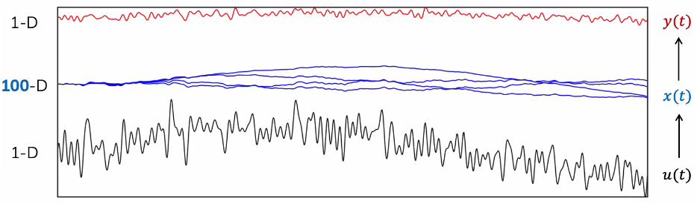
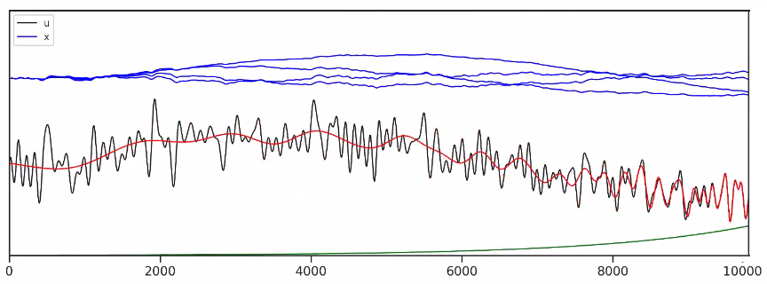
Mamba Model(2023)
State Space Compression

Slide 13
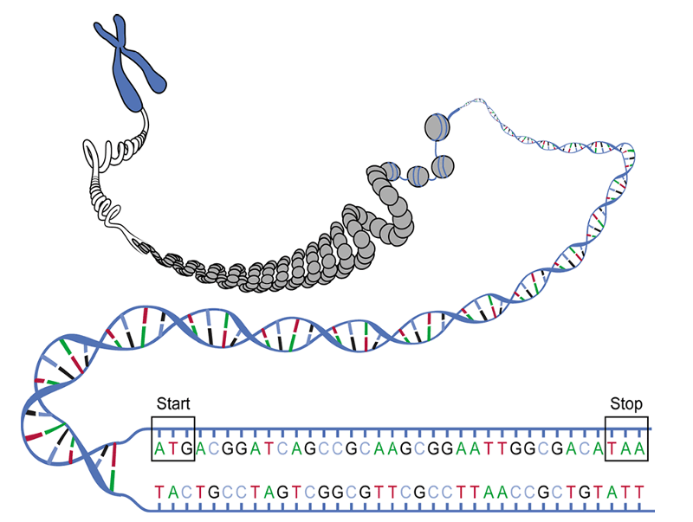
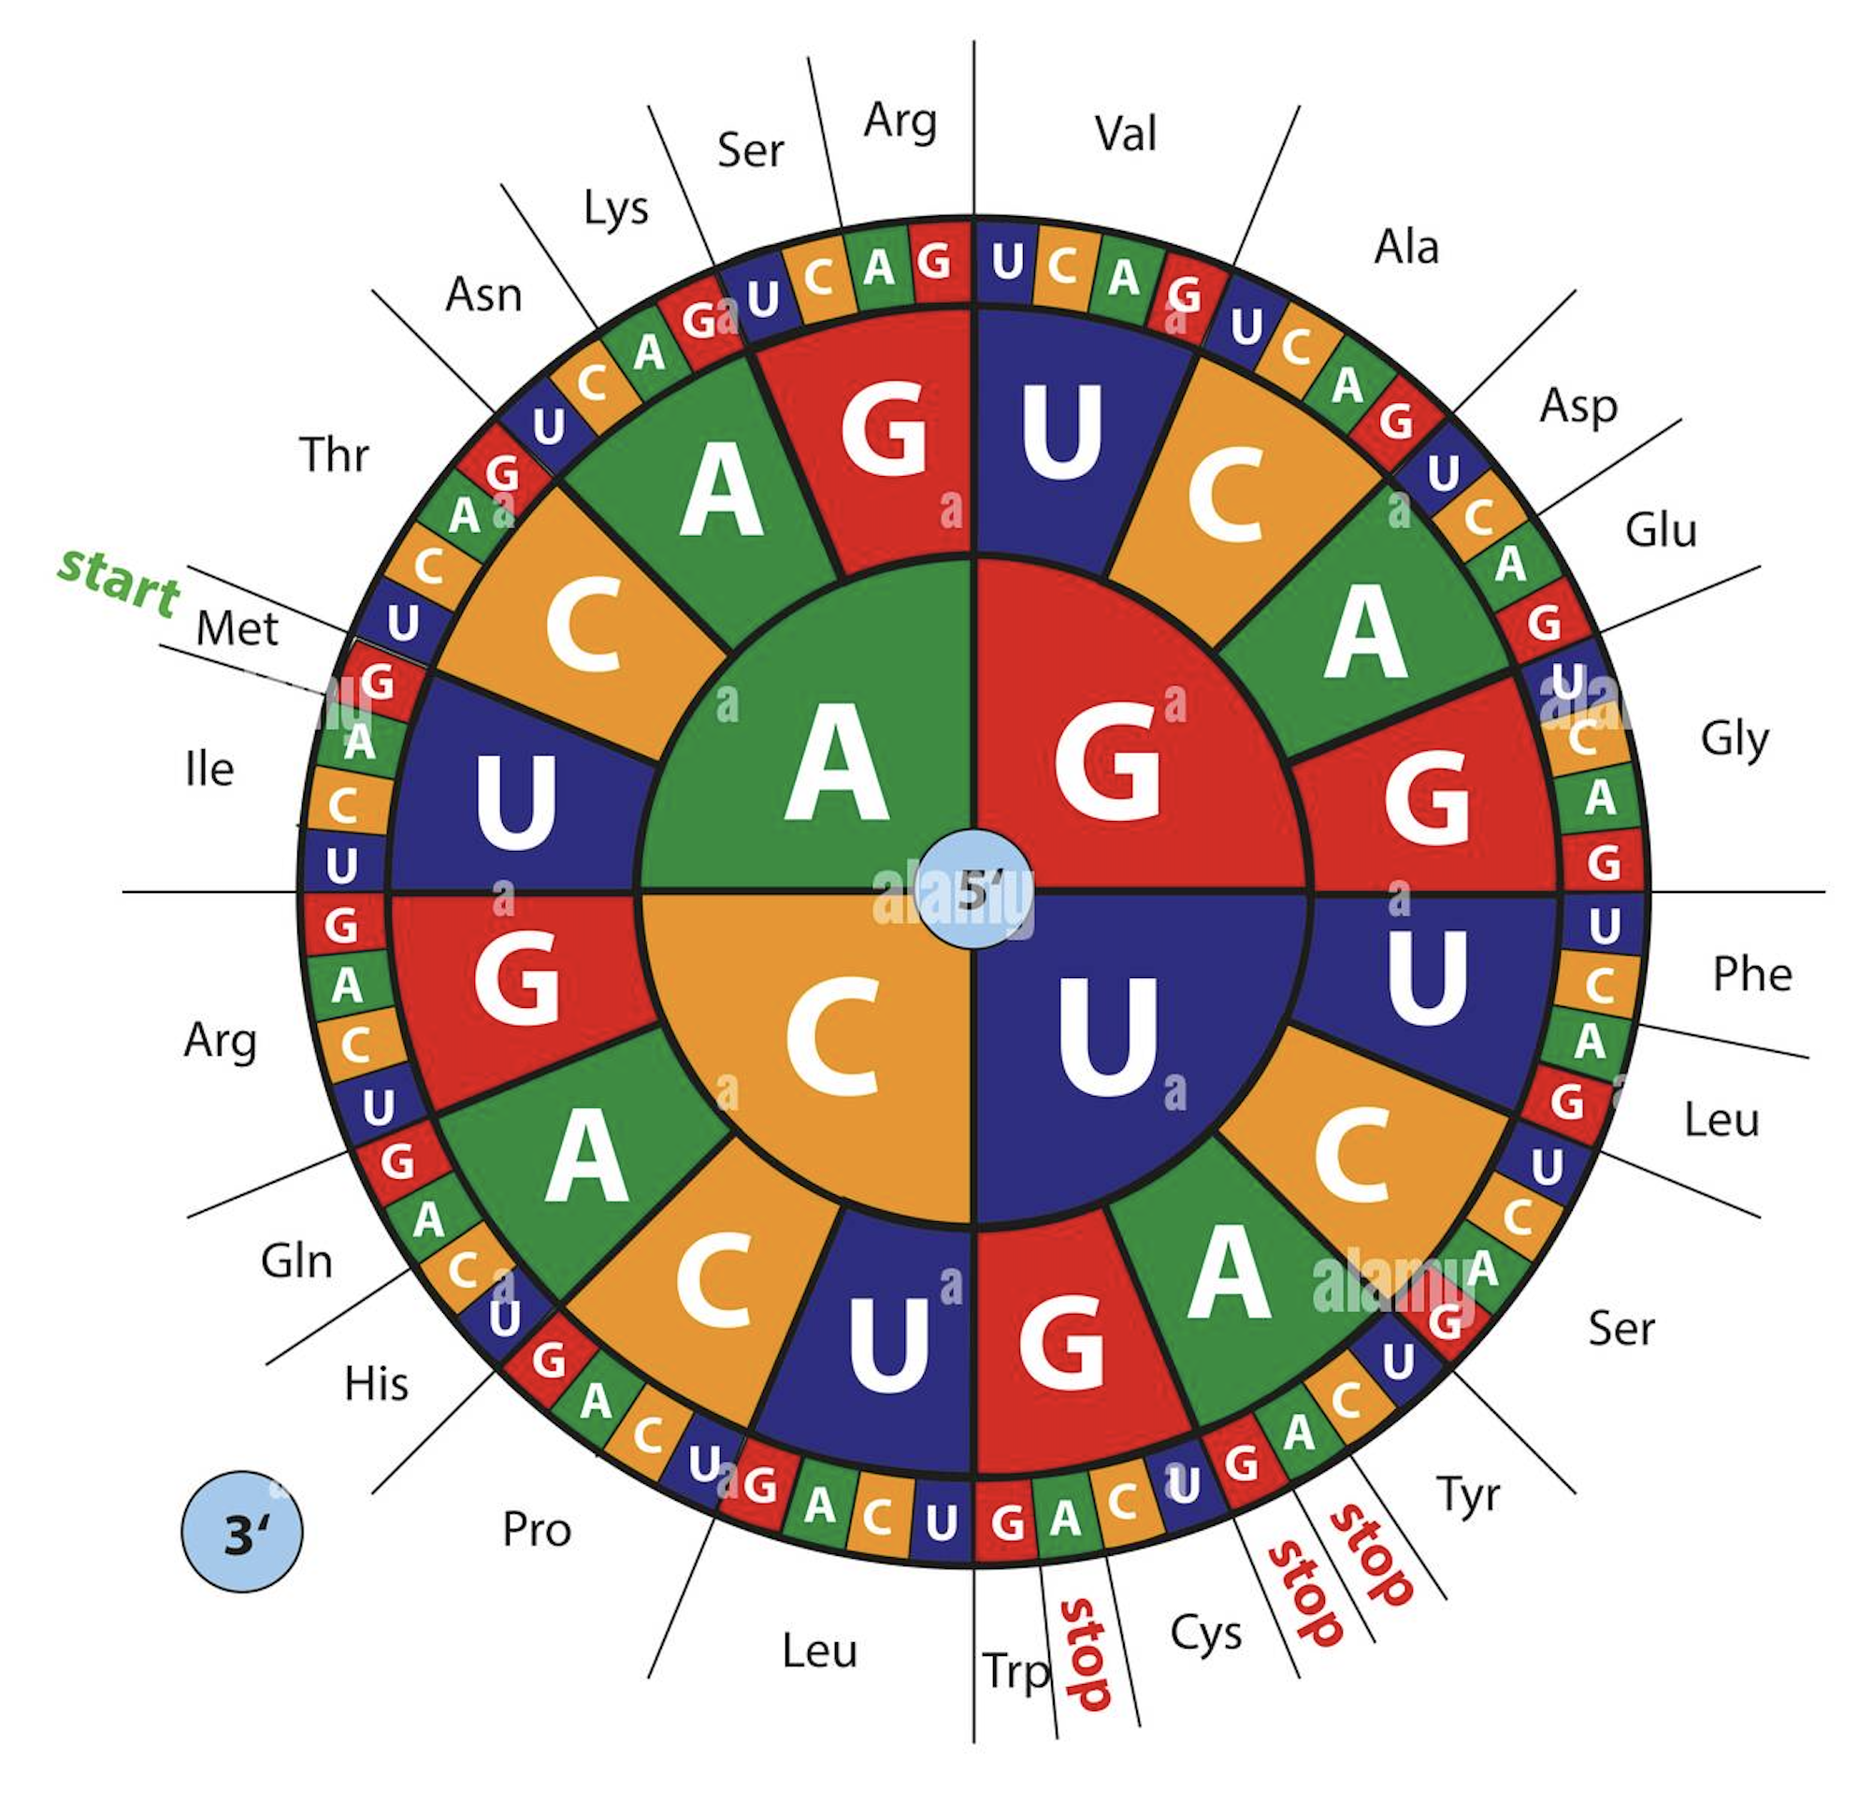
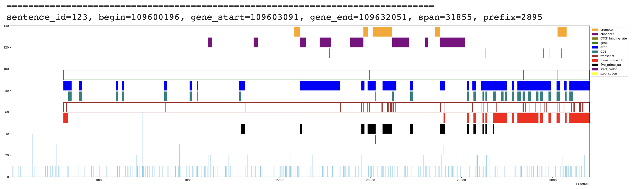
Research Challenges
# 1. How to Wording the DNA sequence.
Base-Pair / K-mer / Byte-Pair Encoding (BPE)
# 2. How to best approximate the system state
under high redundancy and repetitiveness
# 3. How to modeling a highly Non-Linear process.

Slide 14
Thank you!

